Slide 1
Fake news detect using Naïve Bayes
Faculty of Science and Technology, Dept. of Computer Science
Graduate / Undergraduate thesis
Student Name | ID | Contribution
1. Sayed Ali Noor Haque | 17-35423-3 | 25%
2. MD. LOTON | 18-37583-1 | 25%
3. MD. OMAR FARUK | 18-36670-1 | 25%
4. TAREK KHAN | 17-35268-2 | 25%
Supervisor: | MIR MD KAWSUR

Slide 2
Content
Problem definition
Motivation / Background
Research Questions
Methodology
Results / Findings
Synthesis
Future Work

Slide 3
Problem Statement
Misinformation Can Be Harmful to our health.
Negative Effects on the Value of the Company.
More challenging to discern the truth when false information is spread.
Student grades can be affected by Fake News
Social media platforms are heavily affected by fake news.
democracy being undermined
Importance of the research
We Try to make raise awareness among the people about the rumor or fake news and help to identify the fake news through our work. It will also help people to get authentic news too.
Objectives
Using Naïve Bayes method to detect fake news on social media

Slide 4
Background study
Detect fake news on social media
Detect Misleading information
Detect fake news by Using Naïve Bayes classifier
Detect superstition and fake news
Detect Fake News on COVID-19
Identify fake posts
Analysis of the findings

Slide 5
Research Methodology
Dataset
News 39%, Political news 29%, Social media 31%
Survey online based
Text type news

Slide 6
Methodology
Data Pre-Processing
Collected from kaggle
Sanitized the data
Fix structural errors
Remove unwanted data
Remove duplicate data or noise
Handle missing data

Slide 7
Methodology
1. Removal of duplication data
2. Removal of non-categorized data
3. Removal of stop words
4. Removal of null values from text column of news articles
Training Data
Training the classifier
Data pre- processing
Classification
true
Input Data
Data processing
Testing Data
Fake
pre- processing data set
Using Naïve Bayes
Target Fake news identification

Slide 8

Result Analysis: Naïve Bayes algorithm
SR. No. | ALGORITHM | BEFORE APPLYING NAÏVE BAYES | AFTER APPLYING NAÏVE BAYES
1 | Naïve Bayes | 66.8263 % | 91.461 %
2 | Naïve Bayes | 65.736 % | 94.186 %
3 | Naïve Bayes | 74.8999 % | 95.2153 %
4 | Naïve Bayes | 73.8701 % | 95.9911 %
5 | Naïve Bayes | 75.0359 % | 96.3855 %

Slide 9
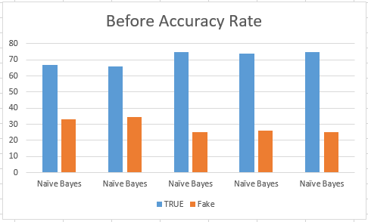
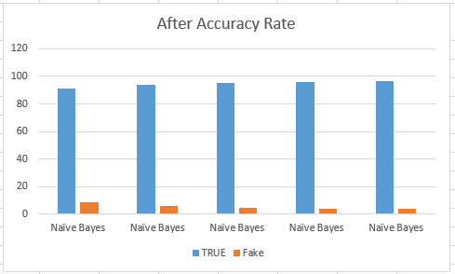
Accuracy Graph

Slide 10


Limitation and scope for future work
Limitation
future work
More research in python
Neural network
modest data handling
Unauthorized data was ineffective
It works based on only the English language

Slide 11
References
[1]. Granik, M. and Mesyura, V., 2017, May. Fake news detection using naive Bayes classifier. In 2017 IEEE’s first Ukraine conference on electrical and computer engineering (UKRCON) (pp. 900-903). IEEE​
​
[2]. Smitha, N. and Bharath, R., 2020, July. Performance comparison of machine learning classifiers for fake news detection. In 2020 Second Conference on Inventive Research in Computing Applications (ICIRCA) (pp. 696-700). IEEE. ​
​
[3]. Sraboni, T., Uddin, M., Shahriar, F., Rizon, R.A. and Polock, S.I.S., 2021. FakeDetect: Bangla fake news detection model based on different machine learning classifiers (Doctoral dissertation, Brac University). ​
[4]. reja, P. R., n.d. GlobalVoices. [Online] Available at: https://globalvoices.org/2019/07/20/fake-news-human-sacrifice-padma-bridge-violence-bangladesh/ [Accessed 20 07 2019].
[5]. Al-Zaman, M. S., 2021. COVID-19-related online misinformation in Bangladesh. Journal of Health Research.
​

Slide 12
Thank You

